Slide 1
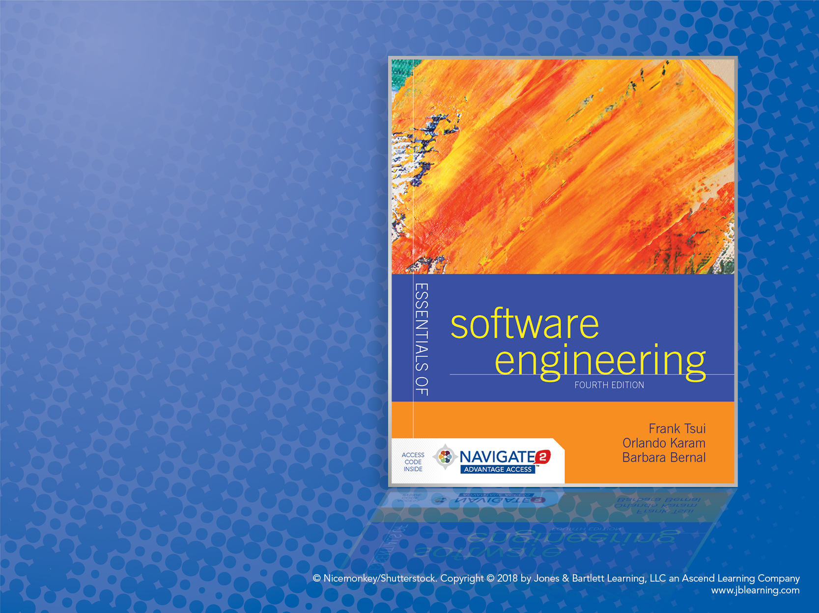
Chapter 4: Software Process Models

Slide 2
What Is a Process Model?
It is a description of
i) what tasks need to be performed in
ii) what sequence under
iii) what conditions by
iv) whom to
achieve the “desired results.”

Slide 3
Why Have a Process Model?
Provide “guidance” for a systematic coordination and controlling of
a) the tasks and
b) the personnel who perform the tasks
Note the key words: coordination/control, tasks, people.

Slide 4
Do we need a process if the project requires just one person or at most two people?
Why? ---- Why not ?

Slide 5
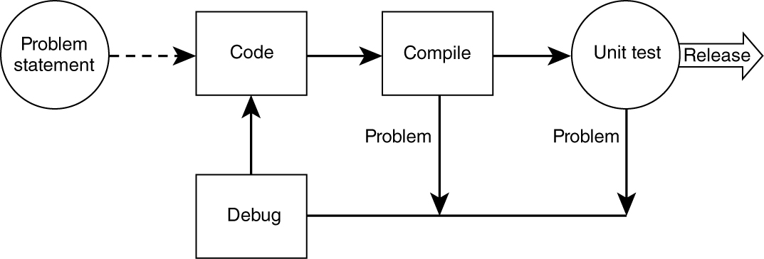
A “Simple and Familiar” Process
1. Most people perform and follow this simple process, but unfortunately some skip unit testing or debugging.
2. Also, some proceed without thoroughly considering & understanding the “problem statement”—which is the requirement.

Slide 6
Extending the “Simple” Process
As projects got larger and more complex:
Needed to clarify and stabilize the requirements
Needed to test more functionalities
Needed to design more carefully
Needed to use more existing software and tools
Database
Network
Code control
Needed more people to be involved
Resulting in more tasks and more people

Slide 7
With More People and More Tasks
We now need to “define”:
the set of tasks that need to be performed
the sequence of flow of the tasks
the input and the output from these tasks
the pre-condition and post-conditions for each task
The people and skills needed to perform the tasks

Slide 8
Some “Traditional” Software Development Processes
The earlier “simple” process was employed by many for years without formally embracing other important development activities such as requirements analysis, design, formal testing, or packaging.
The recognition of the need for formal processes was initially driven by failures in developing large complex software.
Waterfall: earliest process and coping with no process
Incremental: coping with decomposing the large systems
Spiral: coping with risk management
Rational Unified Process: coping with multiple development and management issues

Slide 9
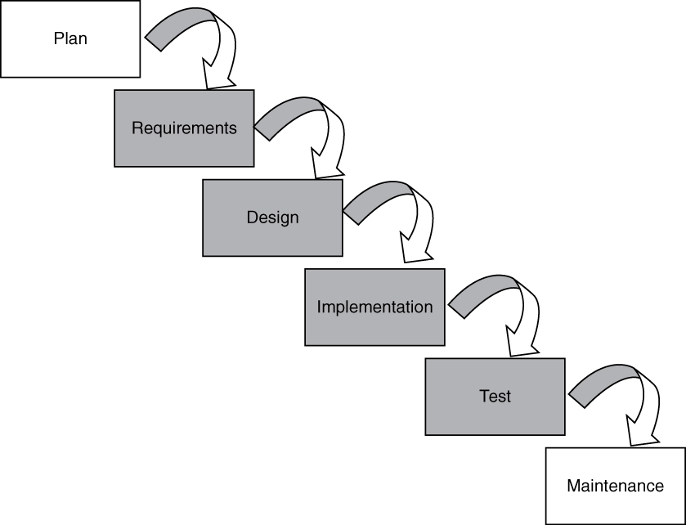
Waterfall Model
1. Requirements must be specified.
2. Four main tasks must be completed in sequence: requirements, design, code, and test, followed by integration.
3. Output of one stage feeds into the next stage in sequence, and thus is easily tracked (“controlled”) by management.

Slide 10
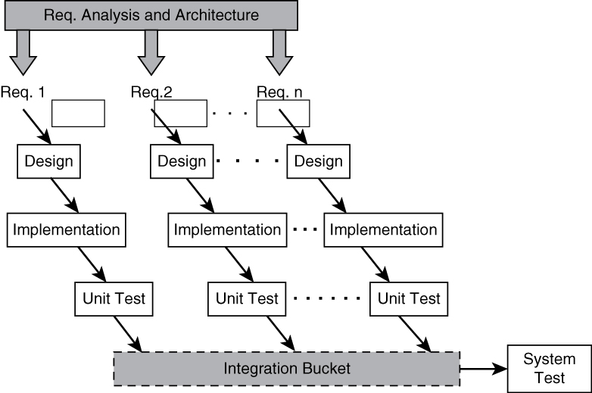
Incremental Model (A) – “Continuous Integration”
Each “major requirement/item” is developed separately through the same sequence of: requirement, design, code, and unit test.
2. As the developed pieces are completed, they are continuously merged and integrated into a common bucket for integrated system test.

Slide 11
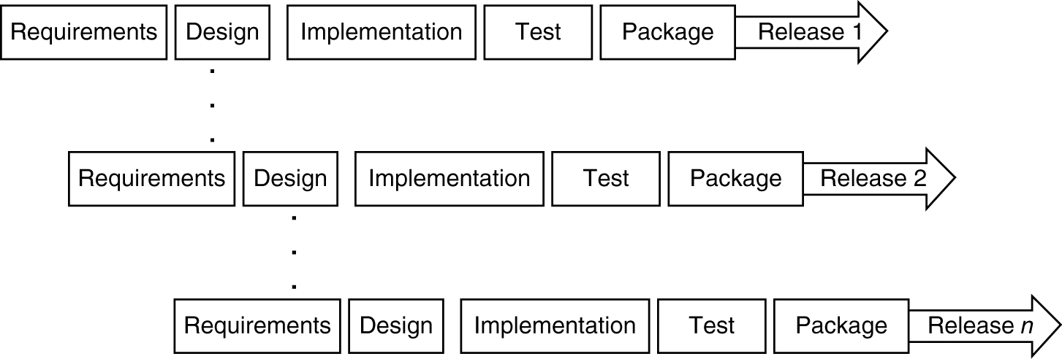
Incremental Model (B) – “Multiple Releases”
Each small set of requirements is developed,
packaged, and released in a multiple release
fashion.

Slide 12
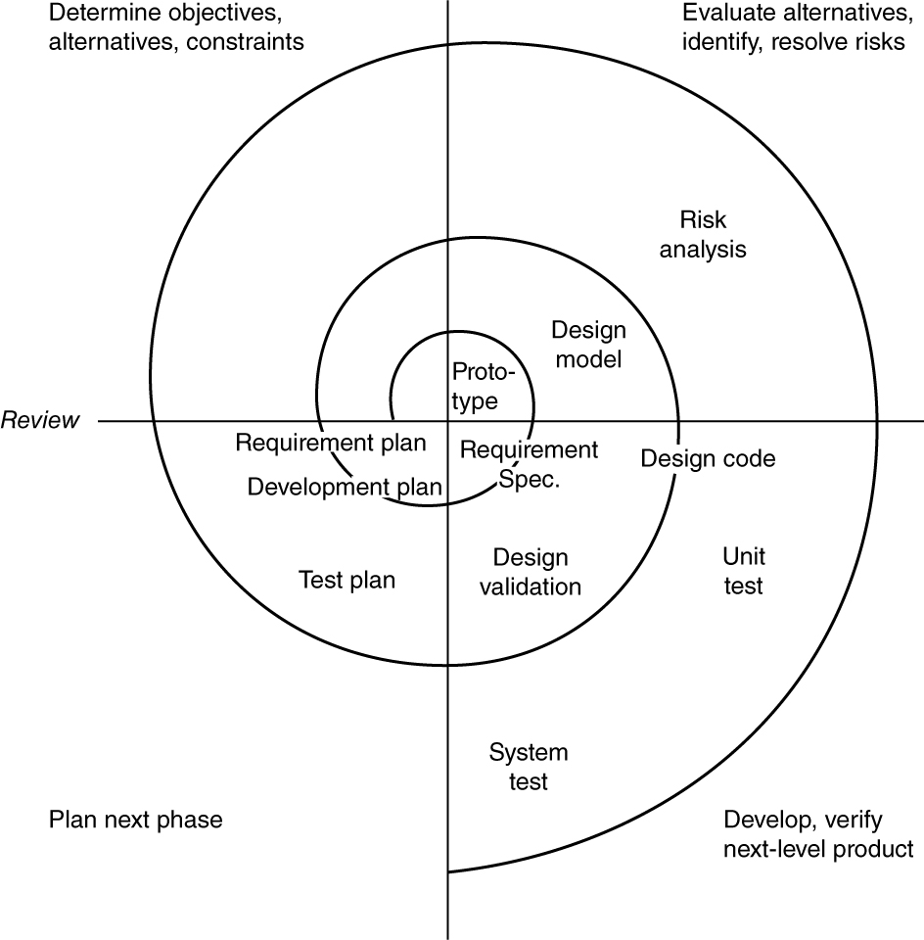
Spiral Model
<INSERT FIGURE 4.5>
– Software development activities are cycled through four phases.
– A “risk-averse” process first proposed by Barry Boehm.

Slide 13
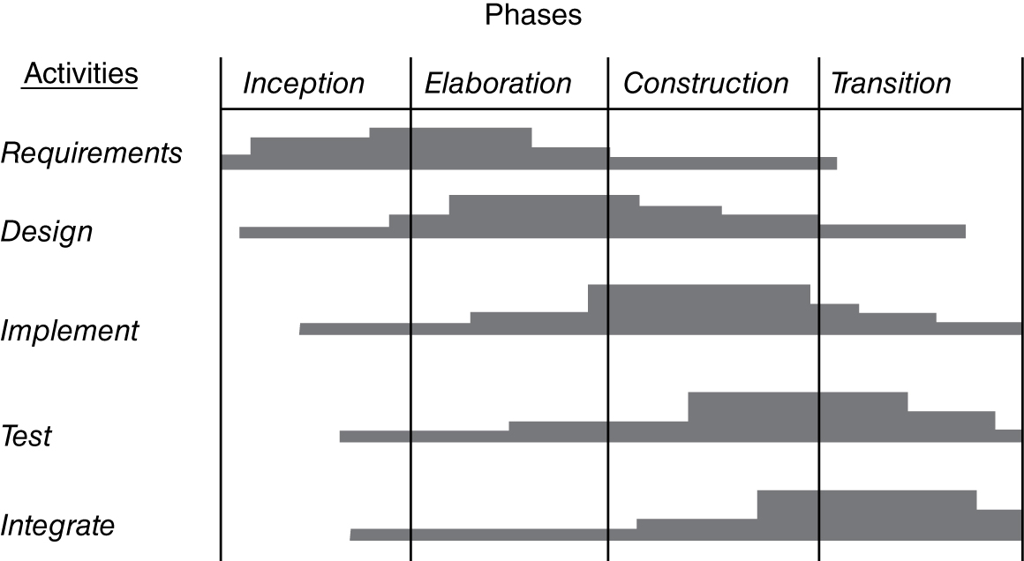
Rational Unified Process (RUP)
Every software development
activity is “addressed” in the four phases of inception, elaboration, construction, and transition.

Slide 14
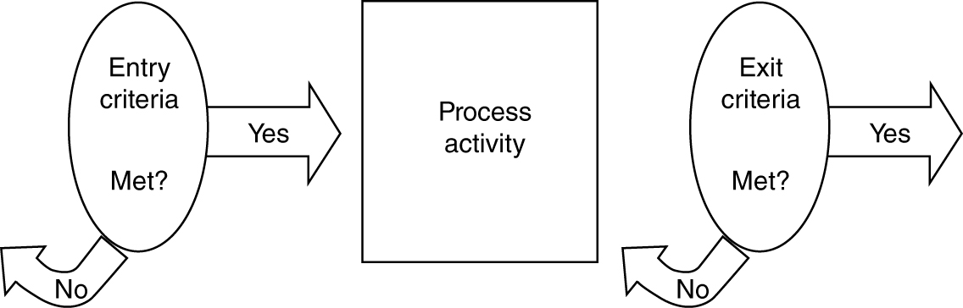
Entry and Exit Criteria
In order for a process model to be more than just
a “guideline,” it must include a list of conditions or
requirements that define the:
– entry criteria prior to performing an activity in a process.
– exit criteria before an activity in the process is deemed completed.

Slide 15
Assessment of Software Organizations
Software development and software support may be done with very little process or with very sophisticated, well-defined, well-organized, and well-executed processes.
How mature is your software engineering organization and do you need to improve?
ISO (ISO 9000 series) and SEI (Software Engineering Institute at Carnegie Mellon) are two leading organizations that help in the process assessment.
No Process
Matured Process
Where are you in
this wide spectrum?

Slide 16
SEI’s Original CMM – Early 1990s
Software Engineering Institute (SEI) proposed a Capability Maturity Model (CMM) to help software organizations assess their maturity and provide guidance in software development.
Initial: there is no process and any success is by luck or with a special person.
Repeatable: has mastered 6 processes and can repeat its success with these 6 processes: 1) requirements management, 2) project tracking, 3) quality assurance, 4) project planning, 5) subcontract management, and 6) configuration management.
Defined: has mastered 7 more processes and is competent at software construction: 1) organization process, 2) training program, 3) product engineering, 4) peer review, 5) organization process definition, 6) integrated software management, and 7) inter-group coordination.
Managed: has introduced 2 more processes that deal with quantitative measurement and quality: 1) quantitative process management and 2) quality management.
Optimizing: reaching this highest level requires the mastering of continuous improvement with 3 more processes: 1) defect prevention, 2) technology change management, 3) process change management.

Slide 17
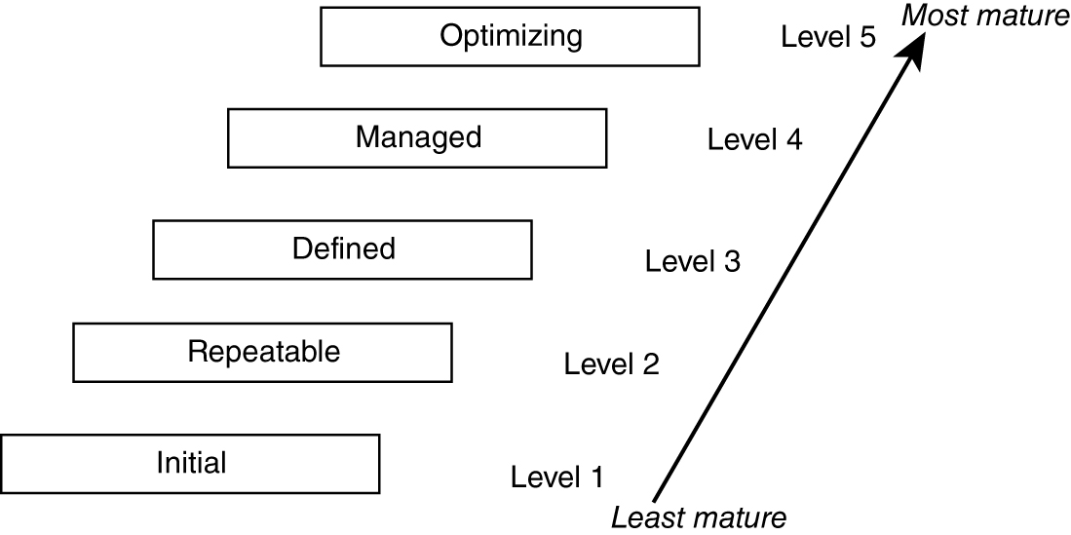
SEI’s Five Levels of Original “Capability Maturity Model” (CMM)
Total of 18 processes need to be mastered to achieve “optimized” level.
See page 77−78 of your text for the 18 “key” processes.

Slide 18
SEI’s CMMI
In 2001, CMM was upgraded to CMMI (CMM Integrated). Started with multiple, major aspects to CMMI:
Systems engineering
Software engineering
Integrated product and process development
Supplier sourcing

Slide 19
Two Representations of CMMI
The software engineering portion of CMMI has two representations:
Staged: similar to the CMM assessment of organization
Continuous: better for assessing maturity of each process

Slide 20
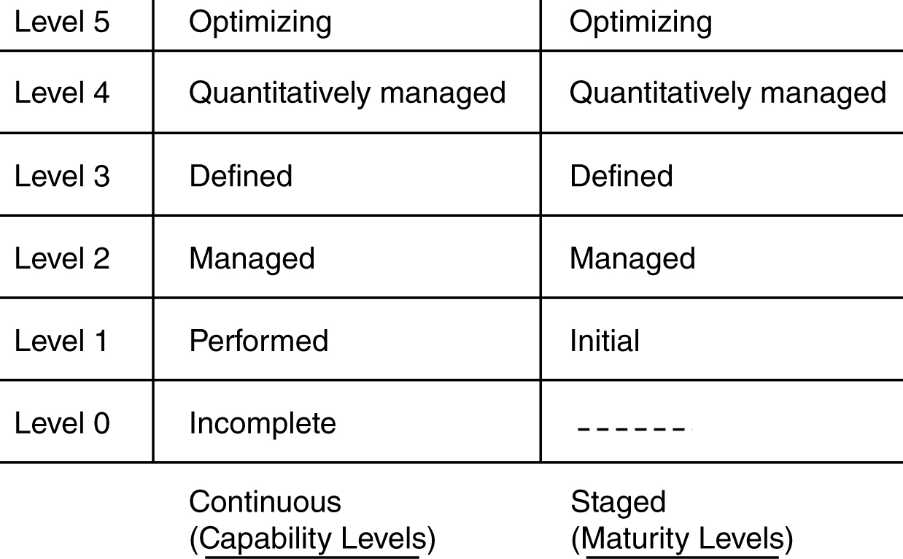
Levels for Continuous versus Staged Models in CMMI

Slide 21
25 Processes of CMMI
There are 25 processes covering 4 major categories:
Process Management (has 5 processes):
Organization process focus
Organizational process definition
Organizational training
Organizational process performance
Organizational innovation and deployment
Project Management (has 8 processes):
Project planning
Project monitoring and control
Supplier agreement management
Integrated project management
Risk management
Integrated teaming
Integrated supplier management
Quantitative project management

Slide 22
25 Processes of CMMI (cont.)
Engineering (has 6 processes)
Requirements development
Requirements management
Technical solution
Product integration
Verification
Validation
Support (has 6 processes)
Configuration management
Process and product quality assurance
Measurement and analysis
Organizational environment for integration
Decision analysis and resolution
Causal analysis and resolution

Slide 23
Continuous versus Staged Models
In Continuous Representation, each process starts at capability level 0 and moves up the capability levels based on achieving “generic goals” and “specific sub-goals.”
Allows the organization to choose and pick the process to focus on based on the needs of the organization.
Allows comparison of process area by process area between organizations.
Allows easier migration from other standards.
In Staged Representation, the organization starts at maturity level 1 and moves up the levels based on mastering sets of processes.
Allows easy migration from the earlier CMM model.
Provides a guidance of sequence of maturity by process areas.
Allows easier comparison of organizations by maturity levels.

Slide 24
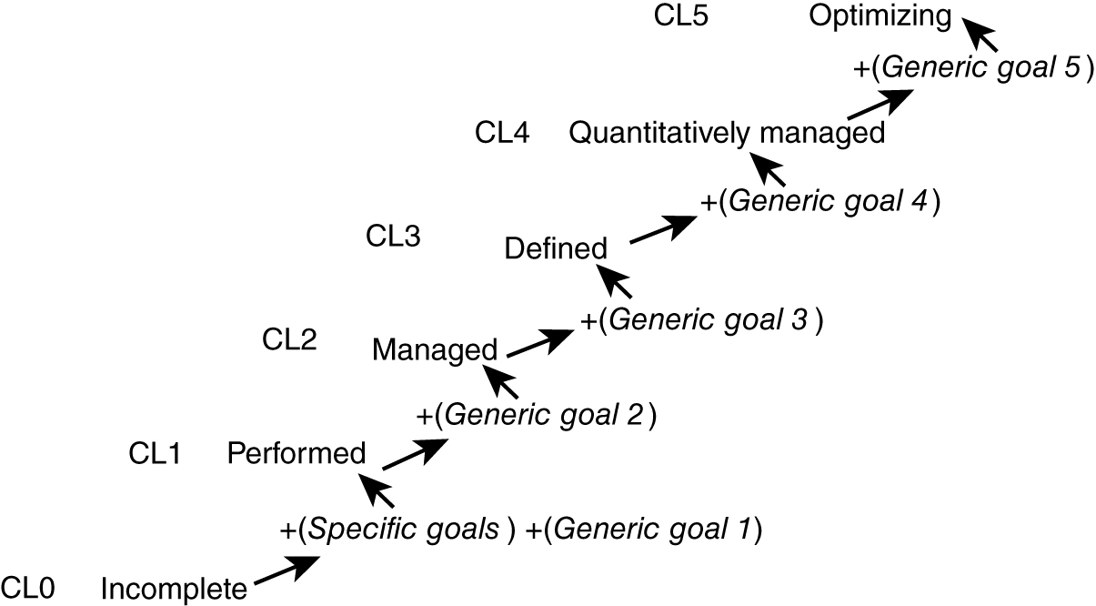
Achieving the “Capability Levels” by Each Process Area in the Continuous Representation Model

Slide 25
Five Generic Goals
Goal 1 – Achieve all the specific goals of the specific process.
Goal 2 – Institutionalize the managing of consistency of that process across organization.
Goal 3 – Institutionalize the defining of that process across the organization.
Goal 4 – Institutionalize quantitatively managing that process across the organization.
Goal 5 – Institutionalize continuous optimizing/improving that process across the organization.

Slide 26
Achieving “Maturity Level” (ML) in the Staged Representation model
ML1 (0 process): no process
ML2 (7 processes): 1) requirements management, 2) project planning, 3) project monitoring, 4) supplier agreement management, 5) measurement and analysis, 6) process and product quality assurance, 7) configuration management
ML3 (14 processes): 1) requirements development, 2) technical solution, 3) product integration, 4) verification, 5) validation, 6) organizational process focus, 7) organizational process definition, 8) organizational training, 9) integrated project management, 10) risk management, 11) integrated teaming, 12) integrated supplier management, 13) decision analysis and resolution, 14) organizational environment for integration
ML4 (2 processes): 1) organizational process performance, 2) quantitative project management
ML5 (2 processes): 1) organizational innovation and deployment, 2) causal analysis and resolution

Slide 27
Process Definition & Communication
Two Main Components of Process Definition:
Major activities
Sequencing of activities
*Most of the organizations need to modify an existing process to better fit their needs — thus they must define in more detail and communicate the modified process definitions (a major endeavor).*
Expanding process definition to more “refined” level:
Detailed description of the activities
Control needed for entrance and exit of each activity and the ordering of the activities
Artifacts that result from the activities
Human resources required to perform the activities
Tools that may be needed to aid the performance of the activities

